Slide 1

Texas oil wells produced water dataset analysis before the Permian oil shale revolution (1920 – 2010)
Springboard Capstone project I
Shubham Tiwari

Slide 2

Introduction: Terms Definition
Produced water: emerges from the earth with crude oil and gas at natural pressures, as wells are drilled and cased (completed)
Permian shale oil revolution: increased oil output from the Permian basin in southern USA due to combination of techniques including:
Horizontal drilling
Multi-stage hydraulically fractured oil-rich shale rock
Hydraulic Fracturing: well-stimulation process of pumping high quantities of frac fluid (primarily water, containing sand and other thickening agents) at high pressures, to fracture tight formations like shale

Slide 3
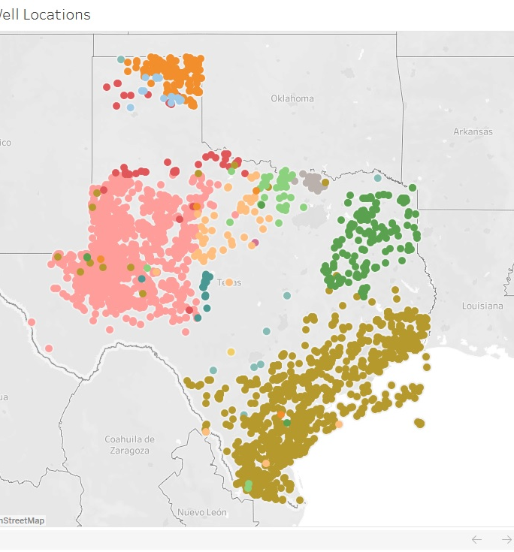
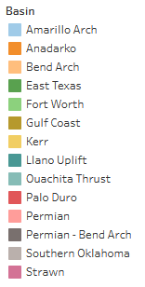
Problem Statement
Hypothesis: Water characteristics (total dissolved solids) were significantly different before the Permian oil shale revolution in 2012
Depths of wells can be found using water quality parameters and basins of origin.
Locations of wells by basin (1920-2010)

Slide 4
Dataset and Motivations of Study
Obtained from United States Geological Survey (USGS) National Produced Waters Database v2.3
To study the effects of fracking on environment, water quality
Significant stakeholders: governments, NGOs, oil producers, water and wastewater companies, politicians, municipalities close to the Permian/Midland region
The Jupyter notebook for the project is available at https://github.com/shubacca/Produced-Waters/tree/master/Produced%20Waters

Slide 5
Data Wrangling and Missing Data Imputations
Initial dataset: 190 features and 19388 entries
Features reduced to 27:
Positional: 'LATITUDE', 'LONGITUDE’
Basin characteristics: 'API', 'BASIN', 'STATE', 'DATECOMP', 'DATESAMPLE', 'FORMATION', 'PERIOD', 'DEPTHUPPER', 'DEPTHLOWER', 'DEPTHWELL', 'LITHOLOGY’,
Water characteristics: 'SG', 'SPGRAV', 'PH', 'TDSUSGS', 'TDS', 'HCO3', 'Ca', 'Cl', 'KNa', 'Mg', 'Na', 'SO4', 'H2S', 'cull_chargeb’
Missing positional values imputed through checks with unique API values and well names
Median values used for missing salts imputation like Ca, Cl, Mg.

Slide 6
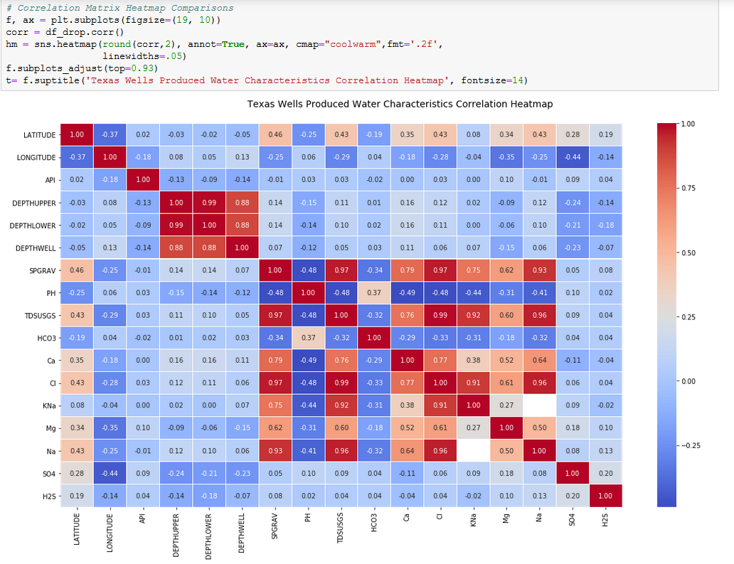
Exploratory Data Analysis
Correlation Heatmap Analysis
Magnesium and calcium don't contribute to TDS as much, suggesting these elements are found in insoluble phases

Slide 7
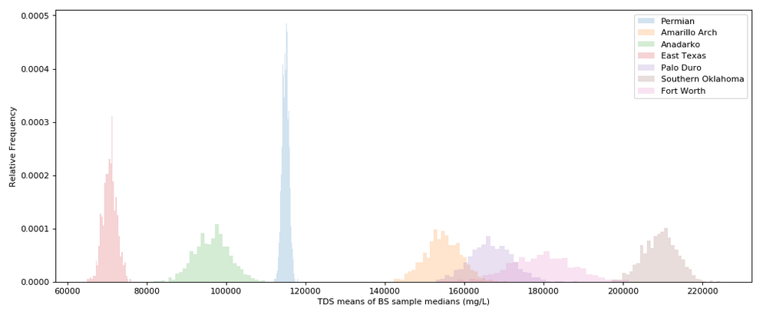
Exploratory Data Analysis
Bootstrapped Tests on TDS Data by Basin
1000 simulations on current dataset aggregated over TDS median values
Results showed Permian basin had the least spread in TDS values as compared to Fort Worth basin

Slide 8
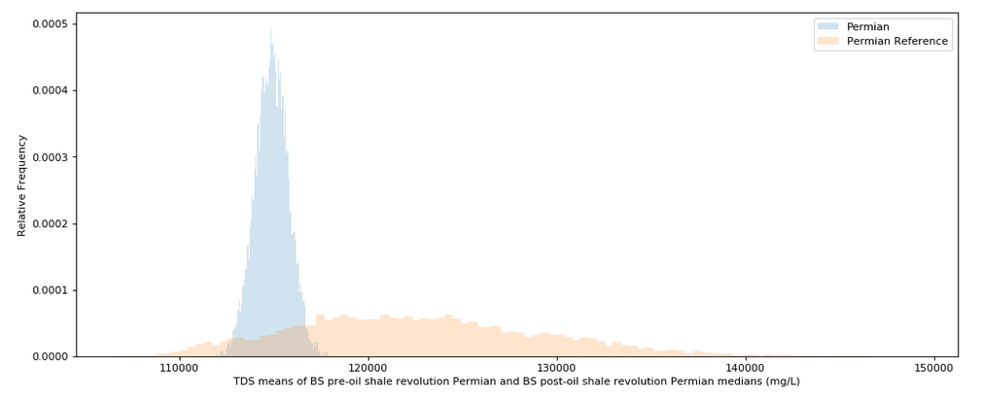
Pre-oil shale revolution TDS values vs. post-revolution: Hypothesis Testing
1000 bootstrapped simulations on current dataset for Permian TDS medians compared with modern values¹
Z-score = 116.77, p-value = 0.0001 => reject null hypothesis => TDS did in fact increase after the revolution
Increase attributed to drilling of more horizontal wells with more minerals and salts seeping in and due to addition of frac fluids
1. Khan, N. A., Engle, M., Dungan, B., Holguin, F. O., Xu, P., & Carroll, K. C. (2016). Volatile-organic molecular characterization of shale-oil produced water from the Permian Basin. Chemosphere, 148, 126–136. doi:10.1016/j.chemosphere.2015.12.116

Slide 9
In-depth Analysis Methodology for Depth Imputation
Solve for Cl, Ca and Na using median imputation.
Drop null TDS values (given that there are only 12 missing).
Separate missing depths data out, and create a test/train dataset with remaining variables.
Test, evaluate and tune different linear regression models to solve for DEPTHUPPER using relevant variables.

Slide 10
Separating Train/Test Data and Model Fitting
Depths related to water quality and basins of origin; hence important predictor features reduced to : latitude, longitude, basin, well type, chlorine, calcium, sodium and TDS concentrations
Steps 1 and 2 easily accomplished using fillna() and filtering for notnull() values from the TDS column
Missing depths first sorted out; remaining data split into 80/20 train/test set
Standard scaling and dummy variable conversion of categorical data: basins (15 kinds) and welltypes (3 kinds)

Slide 11
Algorithms for Regression for Scaled Parameters and their Scores
Algorithm | Parameters | Training R² value | Test R² value | RMSE
Ordinary Least Squares | Default | 0.098 | 0.098 | 2789.5
Lasso Regression | alpha = 0.001, max_iter = 10000 | 0.098 | 0.098 | 2789.5
Ridge Regression | alpha = 0.001, max_iter = 10000 | 0.098 | 0.098 | 2789.5
Stochastic Gradient Descent Regression | max_iter=1000, tol=1e-4, eta0=0.1 | 0.091 | 0.089 | 2803.0
Linear Support Vector Machines Regression | epsilon=.01 | -0.236 | -0.237 | 3266.5
Polynomial Support Vector Machines Regression | kernel='poly', degree=2, C=100, epsilon=1 | 0.060 | 0.064 | 2842.2
Decision Tree Regression | max_depth=15 | 0.861 | -0.139 | 3134.8
Random Forest Regression | max_depth=20, n_estimators=100 | 0.947 | 0.428 | 2221.3
Gradient Boosting Regression | max_depth=20, n_estimators=50, learning_rate=1 | 1.000 | -0.213 | 3235.7
k-Nearest Neighbors Regression | n_neighbors=5 | 0.680 | 0.468 | 2142.2

Slide 12
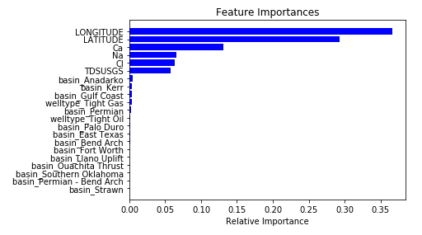
Feature Selection
Feature selection performed using the random forest regressor’s in-built feature_importances_ attribute
Only about 6 features have any major effects on the target depth variable
Running RF regression with only these 6 variables gave similar results, i.e. train score = 0.948, test score = 0.426, RMSE = 2224.8

Slide 13
Algorithms for Regression for Unscaled Parameters and their Scores
Algorithm | Parameters | Training R² value | Test R² value | RMSE
Random Forest Regression | max_depth=25, n_estimators=100 | 0.958 | 0.745 | 1483.8
Gradient Boosting Regression | max_depth=20, n_estimators=50, learning_rate=1 | 1.000 | 0.497 | 2083.9
k-Nearest Neighbors Regression | n_neighbors=5 | 0.410 | 0.122 | 2752.7
Standardization of the latitudes and longitudes doesn’t make much sense, hence the unscaled datasets were run through the top regressors of scaled data, i.e. Random Forest, k-NN and gradient boosting regressors.

Slide 14


Tuning Hyperparameters on Random Forest Model
5-fold cross-validation run on best model (RF)
Best Parameters Results:
Max_depth = 30
N_estimators = 150
Best Score:
Train score = 0.960
Test score = 0.745
RMSE = 1478.4

Slide 15
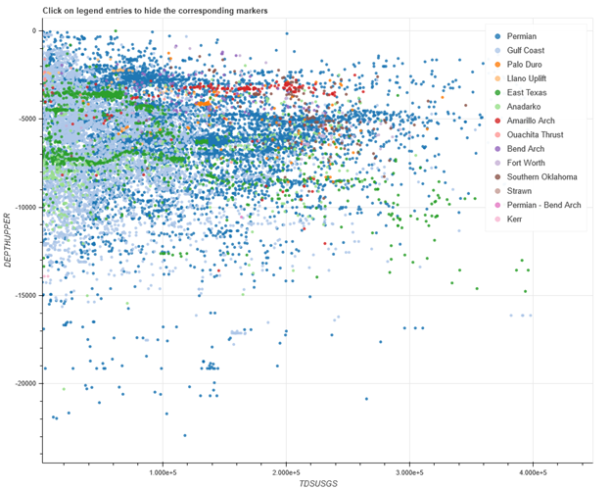
Conclusions and Future Work
Post-Oil Shale Revolution produced waters were significantly higher in TDS concentrations from the pre-revolution waters, found using bootstrapping techniques
Given a R² score of 0.75 on the test data, the missing depths were able to be filled in through a Random Forest Regression model
Future Work:
Gather water quality data after the shale oil revolution, and connect previously drilled wells with newer frac projects on the same well paths
Make predictions given newer horizontal drilling technologies, their completion methods and contribution of different frac stages to quality of flowback water
Interactive Bokeh plot (please refer to Jupyter notebook) of depths versus TDS concentration distribution by basins

